Slide 1
ME 335 SYNTHESIS AND ANALYSIS OF MECHANISMS
Project Presentation:- Four Bar Mechanism For Upper Arm Rehabilitation
Group 2
Atharva Suryarao 23110051
Mitali Ashok Agrawal 23110206
Thrisha Kunala 23110182
Vardayini Agrawal 23110353
Debojit Das 22110067

Slide 2
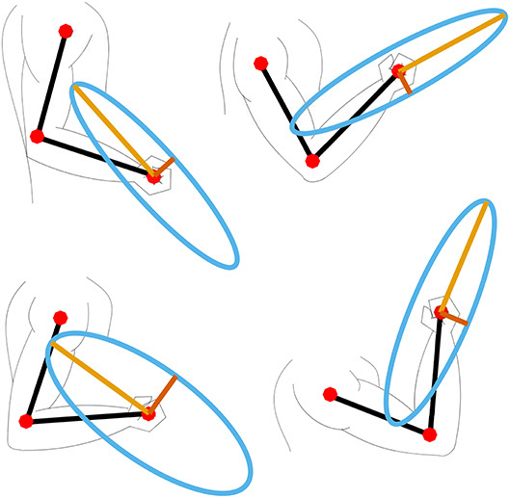

INTRODUCTION
Objective : The objective is to design a mechanical system that can assist in upper arm rehabilitation by generating smooth, controlled, and repeatable motion, while ensuring patient comfort, operational safety, and mechanical feasibility
Motivation: Limited accessibility and consistency in manual rehabilitation highlight the need for simple, repeatable, and low-cost assistive systems.
Approach: A planar four-bar mechanism is used to replicate natural arm motion with a simple single-DOF system.
AI Generated
Figure 1: Human hand different configuration

Slide 3
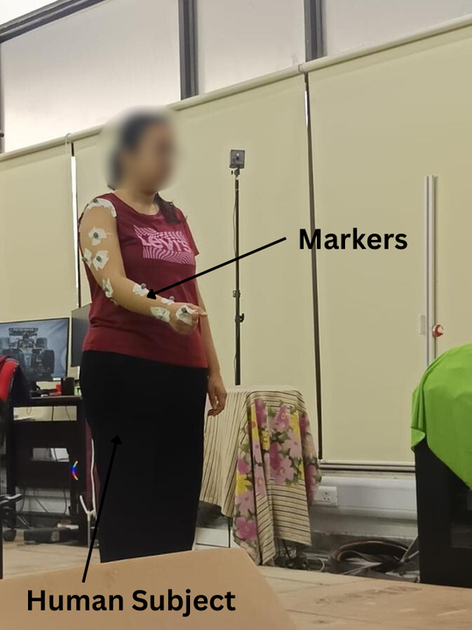
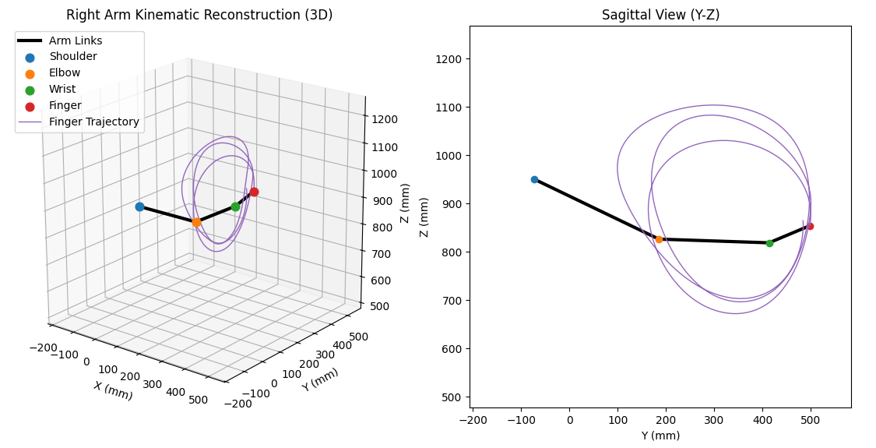
DATA PROCESSING AND KINEMATIC RECONSTRUCTION

Slide 4
MECHANISM SYNTHESIS APPROACH
  We used the graphical synthesis method with three coupler positions and fixed ground pivots to design a four-bar mechanism for upper-arm rehabilitation.
  Key arm positions were selected from the processed motion capture data and used as precision positions.
  The coupler points E and F were chosen on the forearm segment, so that the motion of the forearm could be directly replicated by the mechanism.
  Ground pivot positions were adjusted to achieve:
    Practical link lengths
    Smooth oscillatory motion
    Compact and feasible structure
  Multiple simulations and graphical trials were performed to refine the mechanism dimensions.
FINAL IMPROVEMENTS
  Initial design showed slight jerk near one position.
  Further adjustments in crank length and pivot locations improved reduced jerk.

Slide 5
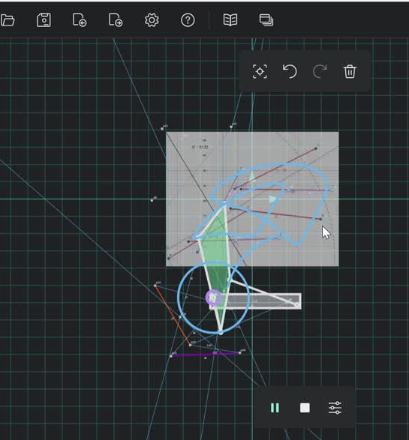
SYNTHESIZED MECHANISM
  Smooth crank-rocker motion
  Perfectly models natural forearm movement
  Practical dimensions for fabrication
  Suitable rehabilitation prototype

Slide 6
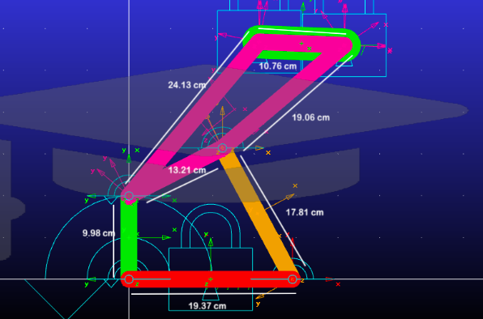
VELOCITY AND ACCELERATION ANALYSIS
Importance of Velocity Analysis
Velocity analysis reveals how the input rotational speed is transmitted and transformed across the links of a mechanism, helping identify regions of fast and slow motion within the cycle. For rehabilitation applications, this is critical to ensure the arm moves within safe and comfortable speed ranges, and to verify that the mechanism does not produce abrupt speed changes that could strain the patient's joints.
Importance of Acceleration Analysis
Acceleration analysis determines the inertial forces acting on the mechanism links, which directly govern actuator torque requirements and structural loading. In the context of upper-arm rehabilitation, excessive acceleration peaks near reversal positions can cause jerky, uncomfortable motion, making this analysis essential for ensuring patient safety and smooth therapeutic performance.
MSC ADAMS MODEL
Notes:
Now I will present the velocity and acceleration analysis of our four-bar rehabilitation mechanism.
After synthesizing the mechanism, it was necessary to study how motion is transmitted through the links. For this purpose, we used MSC ADAMS software, where we simulated the mechanism under constant crank rotation.
Velocity analysis helps us understand how the input rotational speed is converted into motion of the output links.
This is important because:
It identifies fast and slow regions during one cycle.
It ensures the patient’s arm moves within safe speed limits.
It helps us avoid sudden speed changes that may cause discomfort.
For rehabilitation devices, controlled velocity is essential for smooth therapeutic movement.
Acceleration analysis tells us how quickly velocity changes with time.
This is significant because:
High acceleration creates larger inertial forces.
It increases motor torque requirement.
Sudden acceleration peaks can cause jerky motion.
Therefore, acceleration analysis is necessary to ensure patient comfort, structural safety, and smooth operation.
The MSC ADAMS model shown here was used to obtain all the kinematic plots.

Slide 7
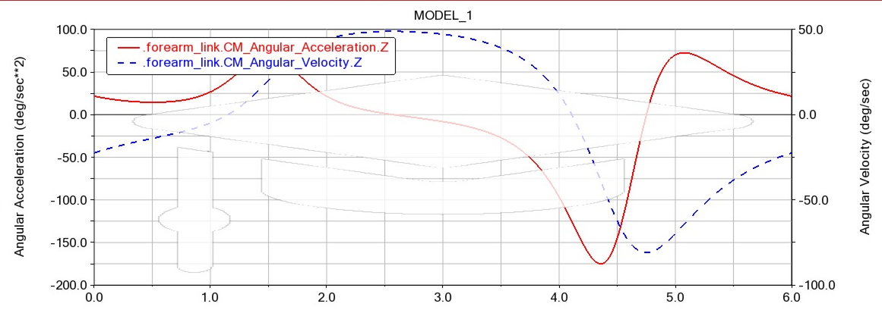
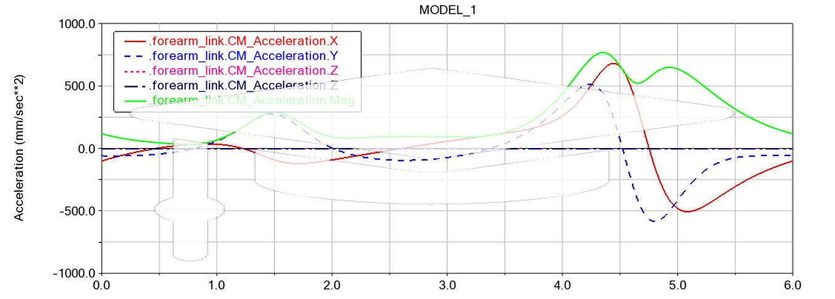
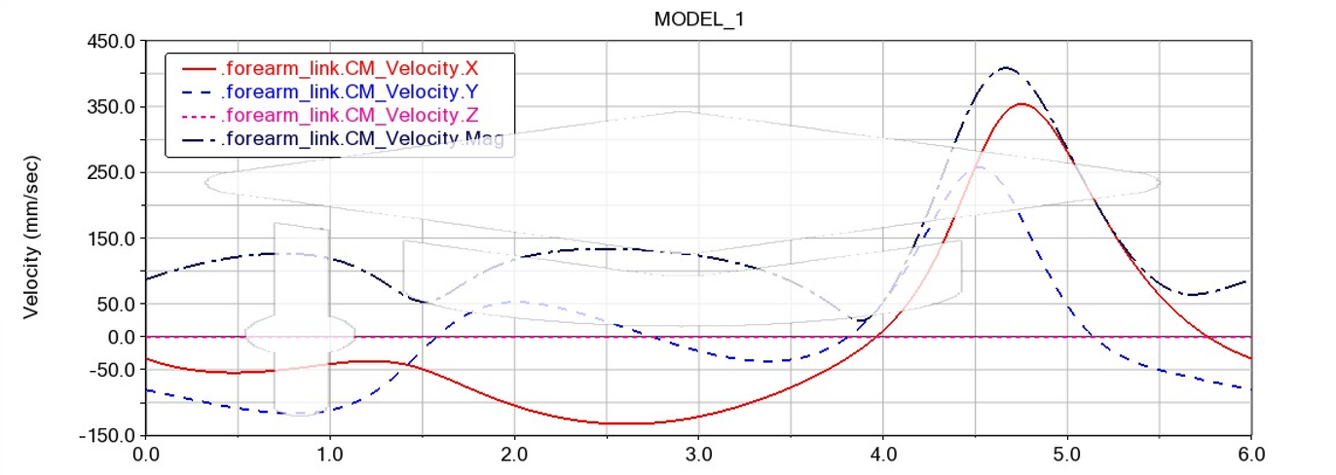
FOREARM LINK VELOCITY & ACCELERATION GRAPHS
Angular Velocity and Acceleration Graph
Linear Acceleration Graph
Linear Velocity Graph
Notes:
Angular Velocity and Acceleration Graph
This graph shows rotational motion of the forearm link.
Observation:
Angular velocity changes continuously during the cycle.
It is not constant because the four-bar mechanism converts constant crank input into variable output motion.
Angular acceleration shows peaks near reversal positions.
Relevance:
This is beneficial because:
Slower motion near extreme positions improves control.
Faster motion in return stroke reduces fatigue.
Controlled acceleration prevents jerks.
So the mechanism gives natural rehabilitation movement.
2. Linear Velocity Graph
This graph shows translational velocity of the forearm link center.
Observation:
Velocity varies smoothly with time.
It increases in the middle region and decreases near end positions.
Relevance:
This means:
Lower speed near turning points improves patient safety.
No sudden discontinuity confirms stable mechanism motion.
3. Linear Acceleration Graph
This graph shows translational acceleration.
Observation:
Peaks are visible near reversal positions.
Remaining motion is smooth and continuous.
Relevance:
This helps in:
Motor selection
Joint force estimation
Ensuring comfortable patient interaction
Overall, the graphs confirm that our mechanism produces:
Smooth repetitive motion
Safe speed levels
Acceptable acceleration values
Controlled upper-arm rehabilitation movement
Thus, velocity and acceleration analysis validates the practical usefulness of our mechanism.

Slide 8
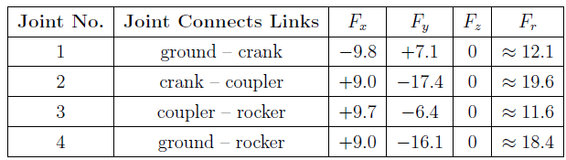
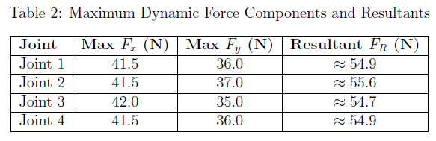
STATIC FORCE ANALYSIS
Crank angle: 90°, Gravity: −9.81 m/s² , Forearm load: -15 N (vertical, applied at COM of coupler)
Setup Conditions
DYNAMIC FORCE ANALYSIS

Slide 9
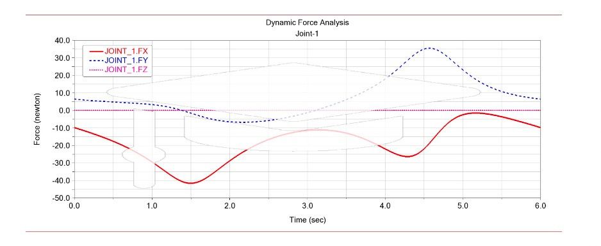
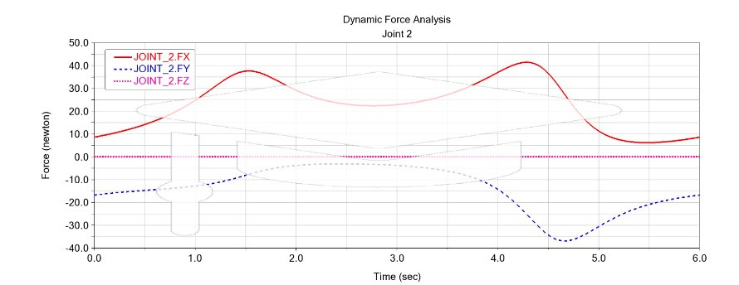
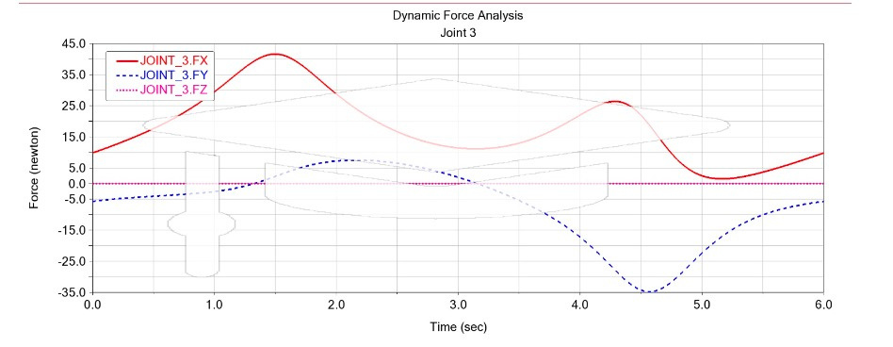
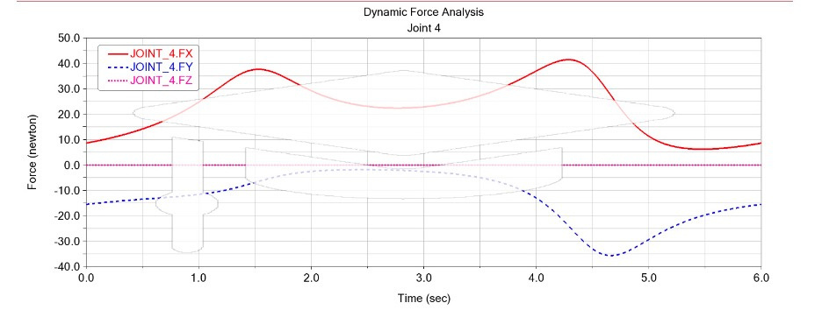
DYNAMIC FORCE ANALYSIS GRAPHS

Slide 10
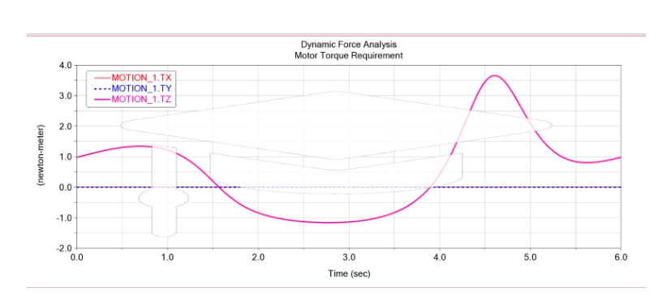
MOTOR TORQUE PLOT
MATERIAL AND COMPONENT SELECTION
  Chosen Material is Carbon Fibre since it is 41% lighter than aluminium (2700 kg/m³), 80% lighter than steel (7800 kg/m³)
  Corrosion-resistant such that it is suitable for healthcare/rehabilitation environments.
The motor torque varies cyclically between −1.2 N·m and +3.7 N·m, with a safety factor of 2 giving a rated torque of 7.4 N·m and a required mechanical power of ~7.75 W at 1.047 rad/s. Accounting for system inefficiencies and transient conditions, a motor in the 15–25 W range is recommended for reliable continuous operation.
The maximum dynamic joint load of 55.6 N, scaled by a service factor of 3, gives a design load of ~167 N. A 608-2RS sealed deep-groove ball bearing is selected due to predominantly radial loading, offering a dynamic load rating of 3.3 kN and a safety factor of ~19.8, confirming a highly robust and reliable bearing choice for the application.
  Recommended bearing: 608-2RS sealed deep-groove ball bearing
  Recommend Motor:- A 15–25 W motor is recommended.

Slide 11
ACKNOWLEDEMENTS
We would like to express our sincere gratitude to professor Vineet Vashista and teaching assistants - Mr. Vardan Mittal and Mr. Aaditya Paresh Nimkar,for their invaluable guidance and support throughout this project. We are also thankful for the opportunity to utilize the laboratory facilities for data collection, which was essential to the successful completion of this work.
THANK YOU
CLICK HERE TO ACCESS PROJECT FOLDER

